Slide 1
Taking DevOps to the Next Level with GitHub and Azure DevOps
Stanley Goldman, GitHub
Steven Borg, Azure DevOps

Slide 2
Event name or presentation title
Subtitle or speaker name

Slide 3
Follow along (later)
GitHub repo: https://github.com/Microsoft/ContosoAir
Demo generator: https://azuredevopsdemogenerator.azurewebsites.net/
Walkthrough: https://github.com/hsachinraj/GitHub-AzureDevOps
GitHub Extension for VS: https://visualstudio.github.com/

Slide 4





Deliver
with Azure DevOps
Azure Boards
Azure Repos
Azure Pipelines
Azure Artifacts
Azure Test Plans

Slide 5
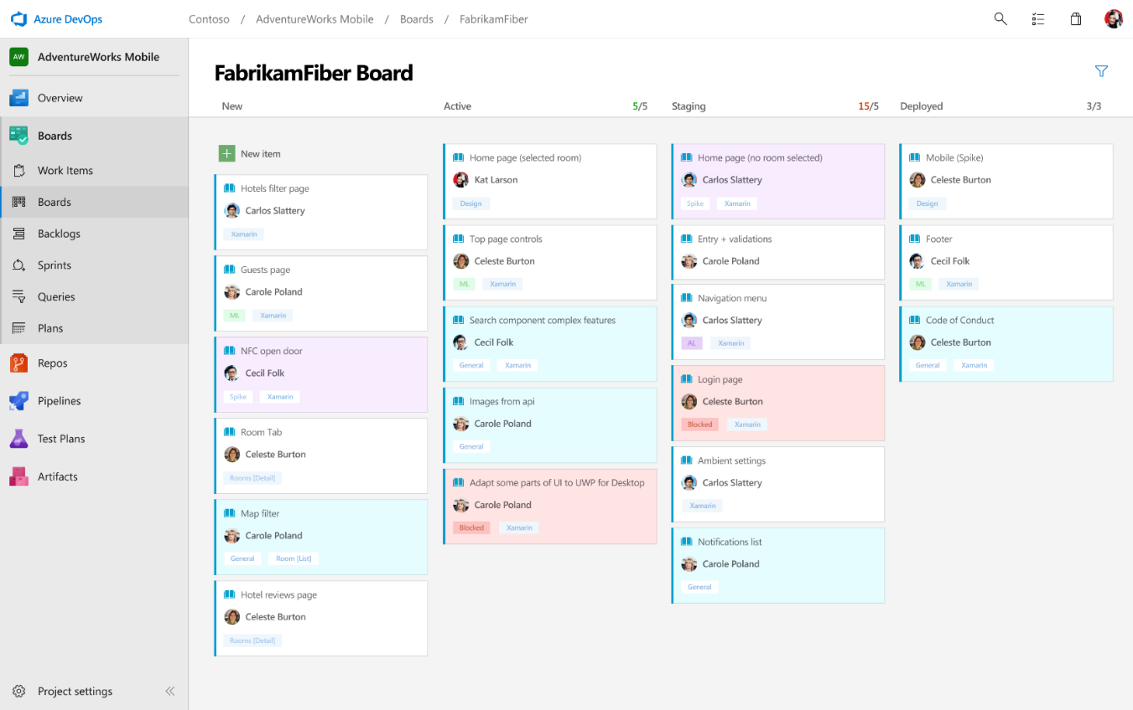
Deliver
Azure Boards
Azure Repos
Azure Pipelines
Connecting ideas to releases
Scrum ready to help your teams run sprints, stand-ups, and plan work
Integrated with GitHub commits and pull requests
Insights into project status and health
Azure Artifacts
Azure Test Plans

Slide 6
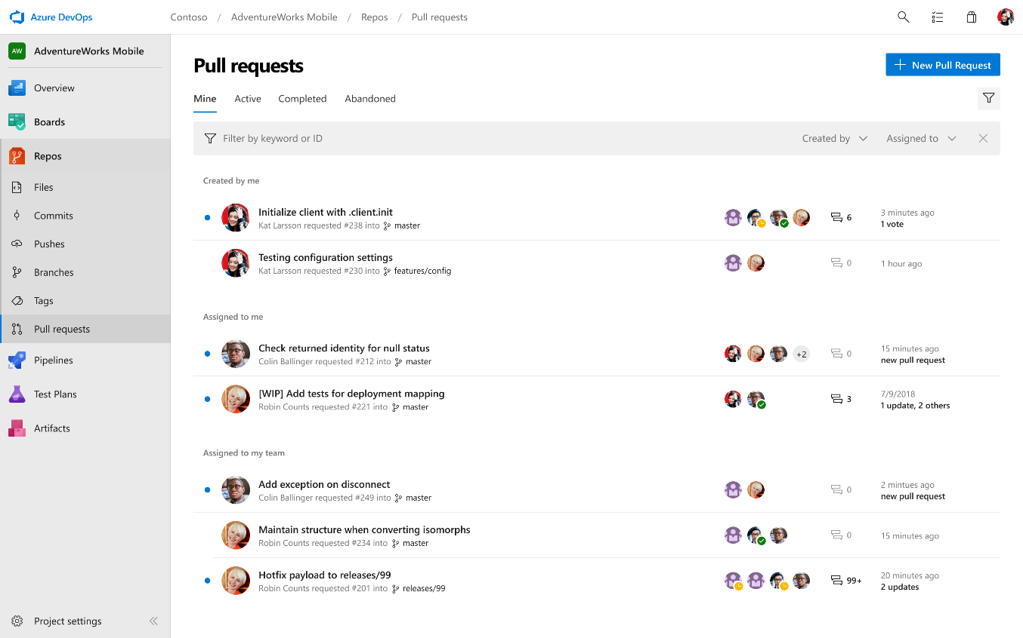
Deliver
Azure Boards
Azure Repos
Azure Pipelines
Private Git and TFVC repos for your teams
Code review via branch pull requests
Branch policies and build validation
Easy migration path to / from GitHub
Azure Artifacts
Azure Test Plans

Slide 7
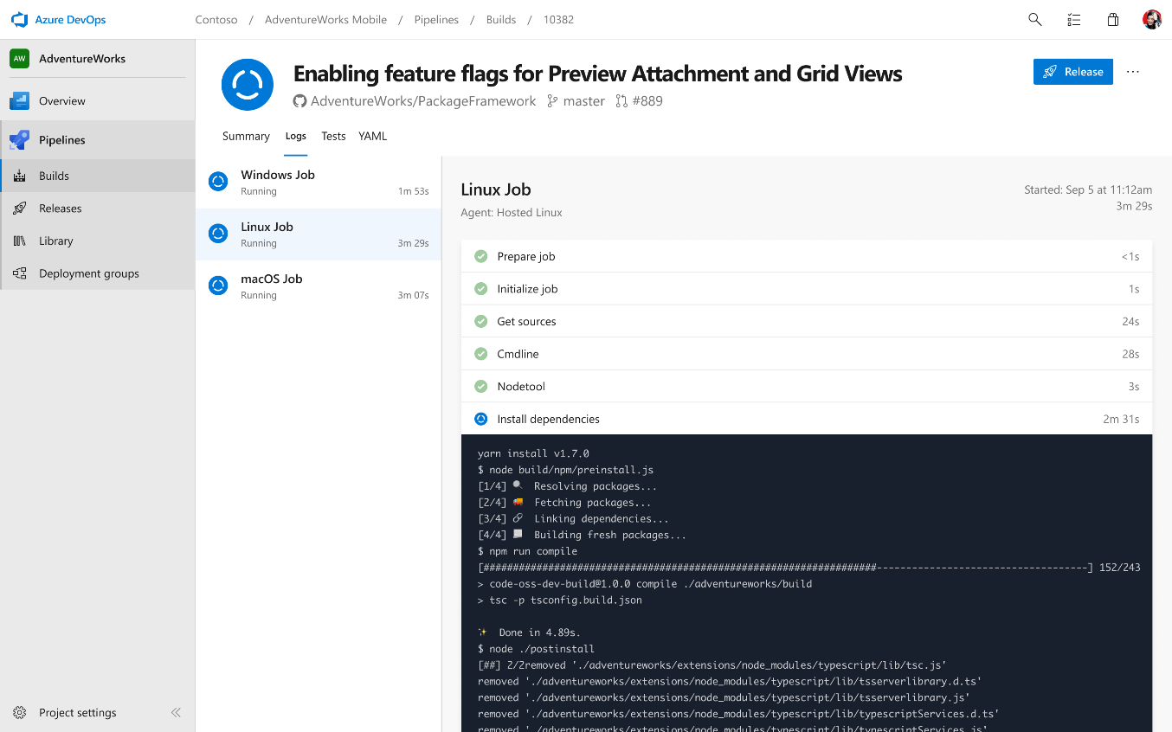
Deliver
Azure Boards
Azure Repos
Azure Pipelines
Cloud-hosted pipelines for Linux, macOS and Windows
Any language, any platform, any cloud
Native support for containers and Kubernetes
Best-in-class for open source
Azure Artifacts
Azure Test Plans

Slide 8
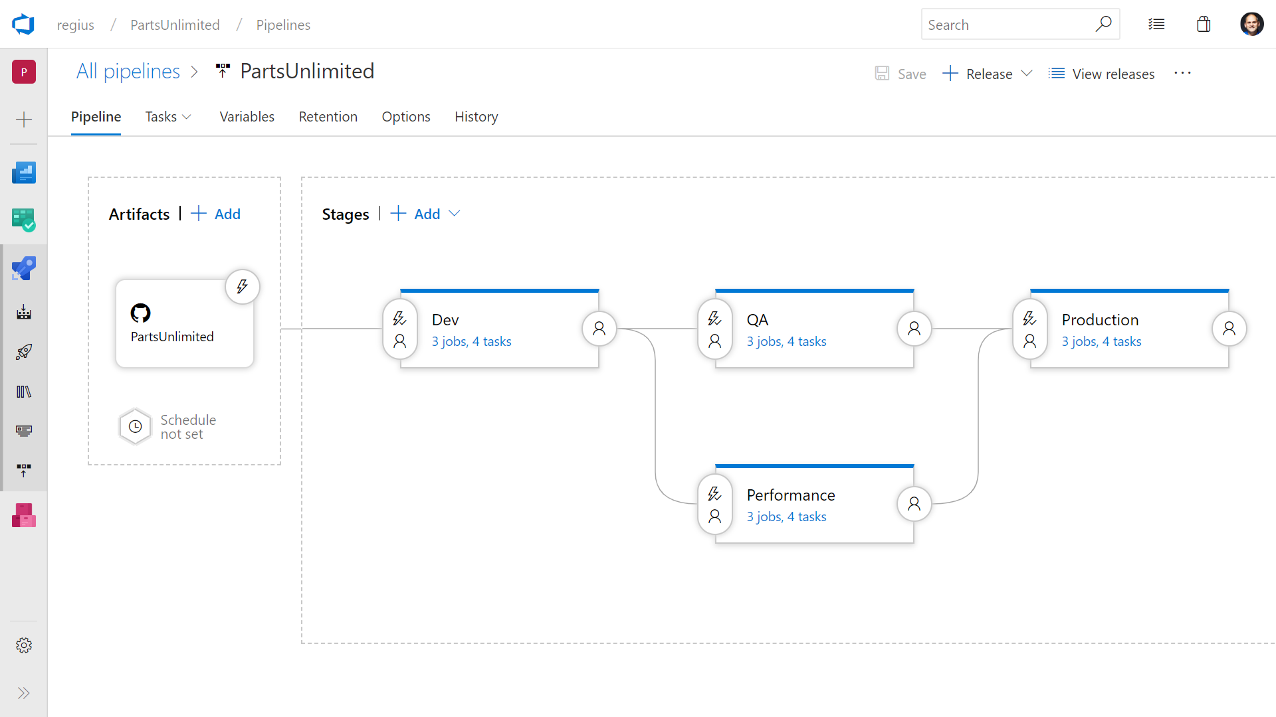
Deliver
Azure Boards
Azure Repos
Azure Pipelines
Deploy to on-premises, ANY cloud or a hybrid of cloud and on-prem
Staged environment releases
Pre and post deployment approvals with gates to automate approval based on conditions
Azure Artifacts
Azure Test Plans

Slide 9
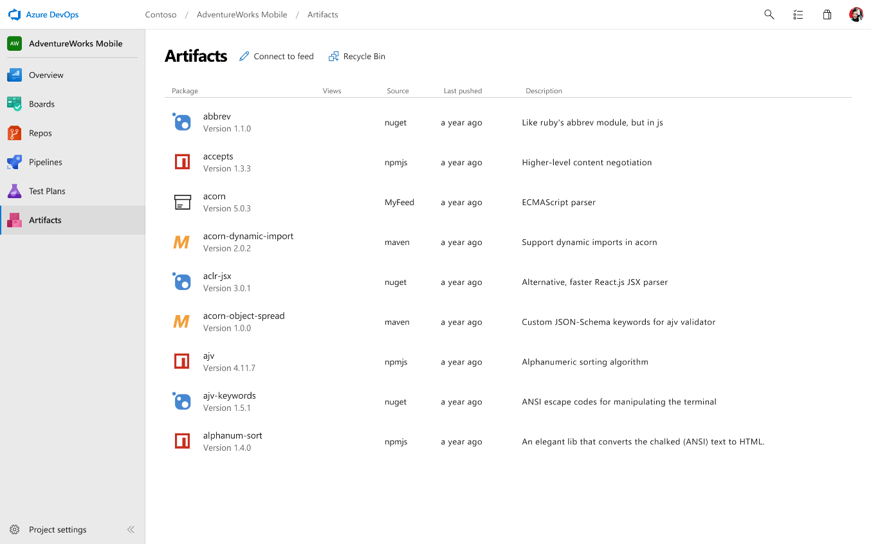
Deliver
Azure Boards
Azure Repos
Azure Pipelines
Manage all package types
Add packages to any pipeline
Share code efficiently
Azure Artifacts
Azure Test Plans

Slide 10
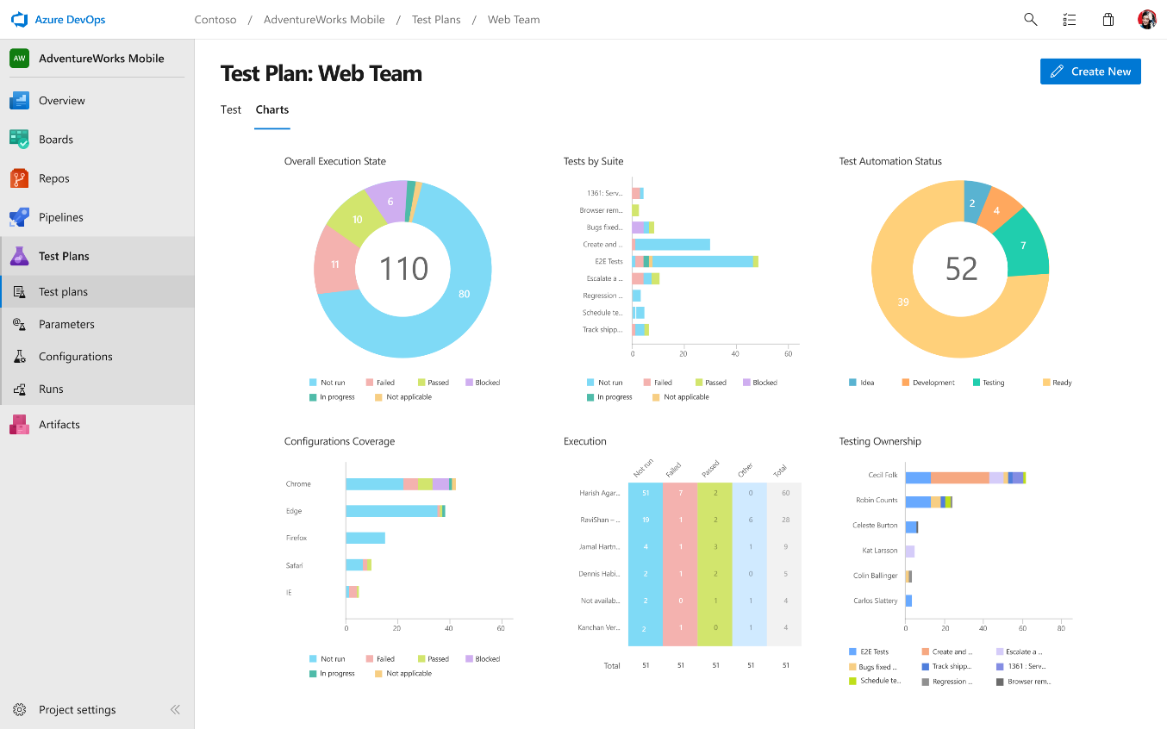
Deliver
Azure Boards
Azure Repos
Azure Pipelines
Run tests and log defects from your browser
Track and asses quality throughout your lifecycle
Capture rich data for reproducibility
Create tests directly from exploratory sessions
Azure Artifacts
Azure Test Plans

Slide 11

Deliver
with
GitHub brings the premier social coding workflows to your team, breaking down silos and enabling Inner Source through:
Expertise sharing
Cross-team collaboration
Improved code reuse
Increased velocity
Azure Boards
Azure Repos
Azure Pipelines
Azure Artifacts
Azure Test Plans

Slide 12


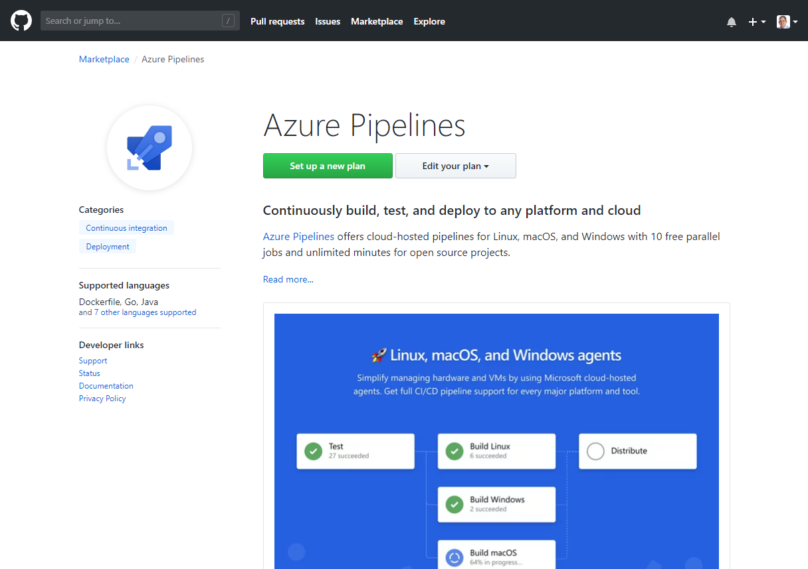
Azure DevOps Integrated with GitHub
Rich integration with Azure Pipelines and Azure Boards

Slide 13
Demo
Stanley and Steve

Slide 14
Questions?

